Slide 1
TEAM 5
GIT REPOSITORY
OWNER: Monil
Contributor: Dheeraj

Slide 2
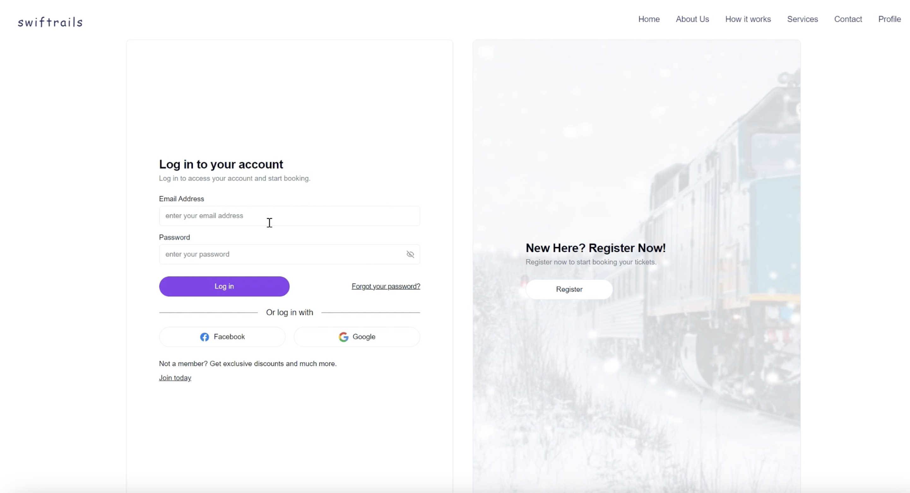
Login Info

Slide 3
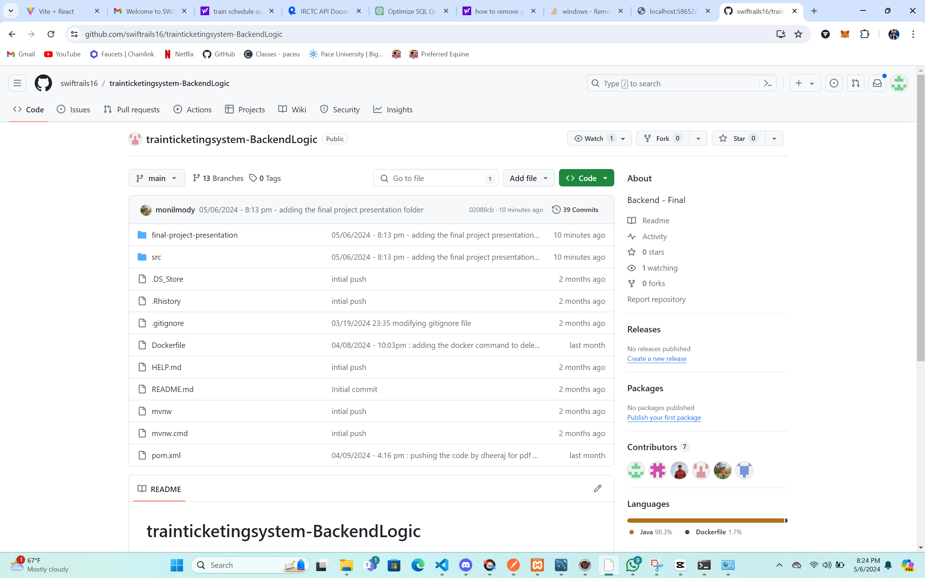
GIT HUB REPOSITORY

Slide 4
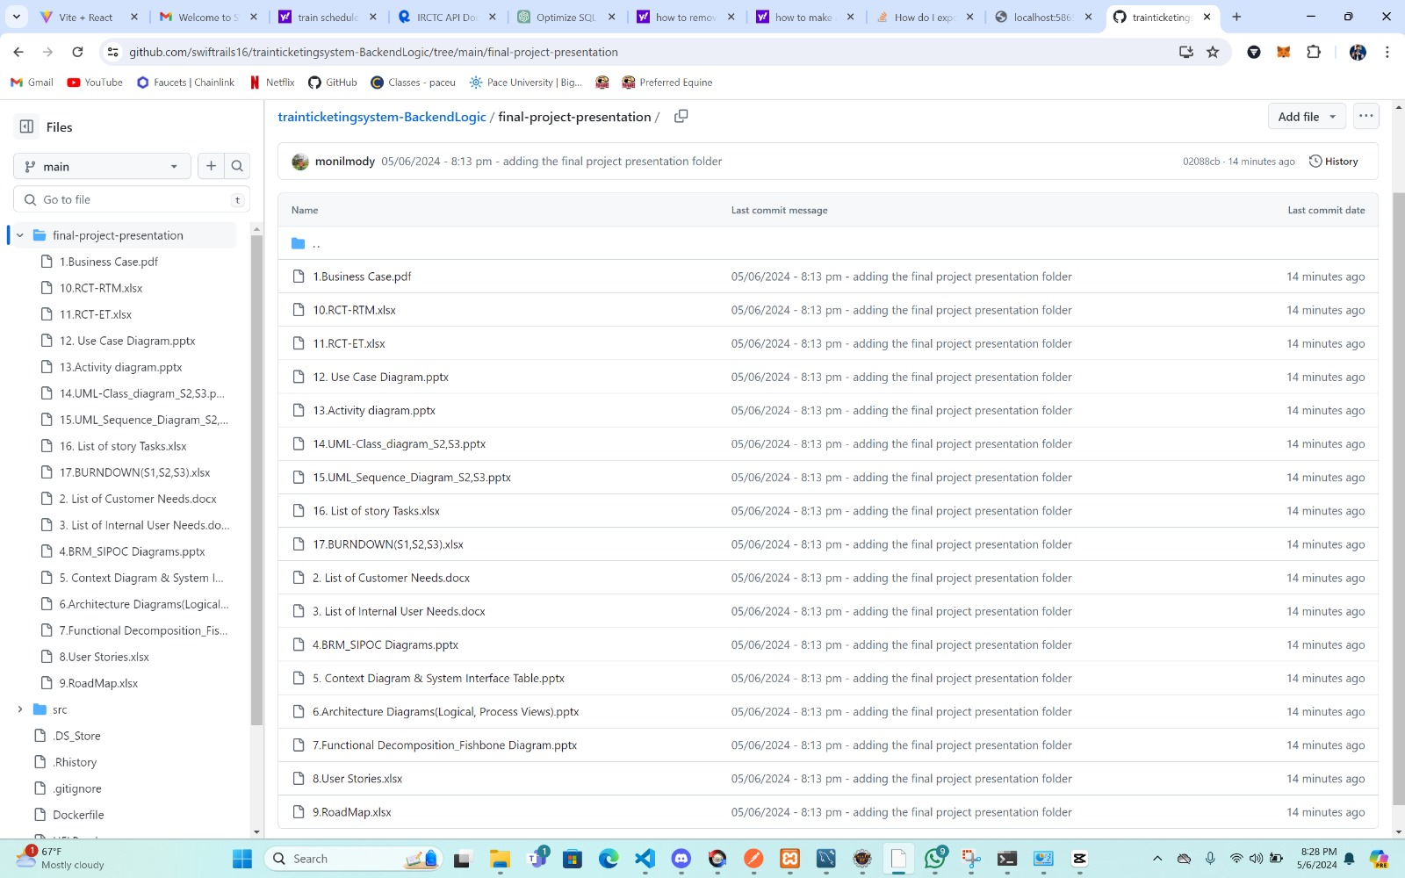

Slide 5
T5 SAMPLE SOURCE CODE
OWNER: DHEERAJ
CONTRIBUTOR: DIPESH

Slide 6
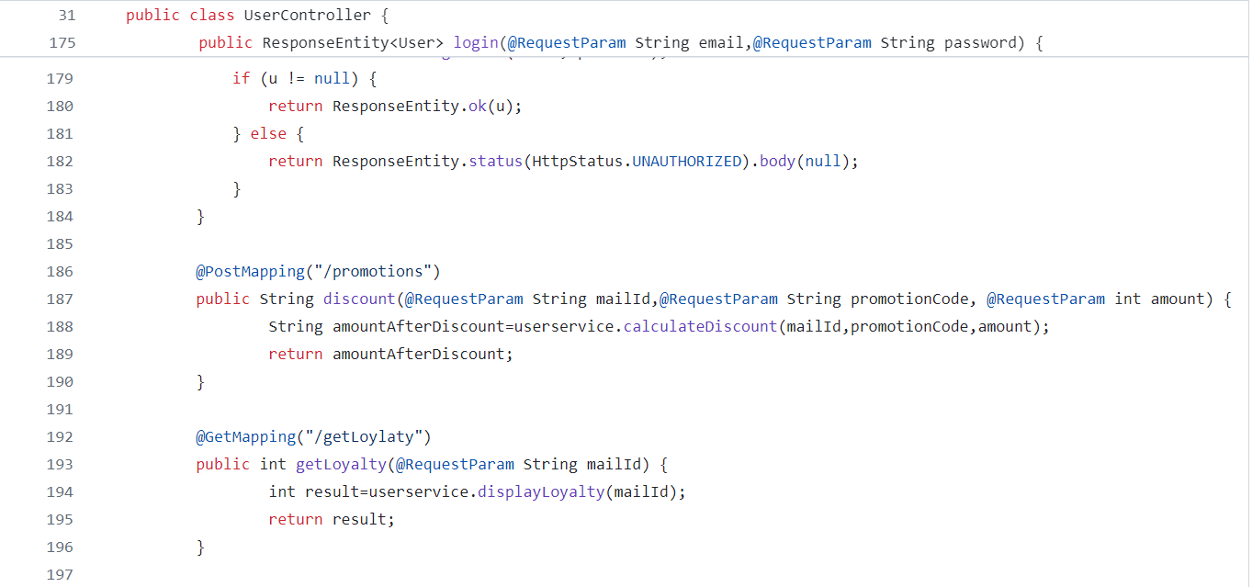
03.03 PROMOTIONS AND DISCOUNTS
CONTROLLER

Slide 7
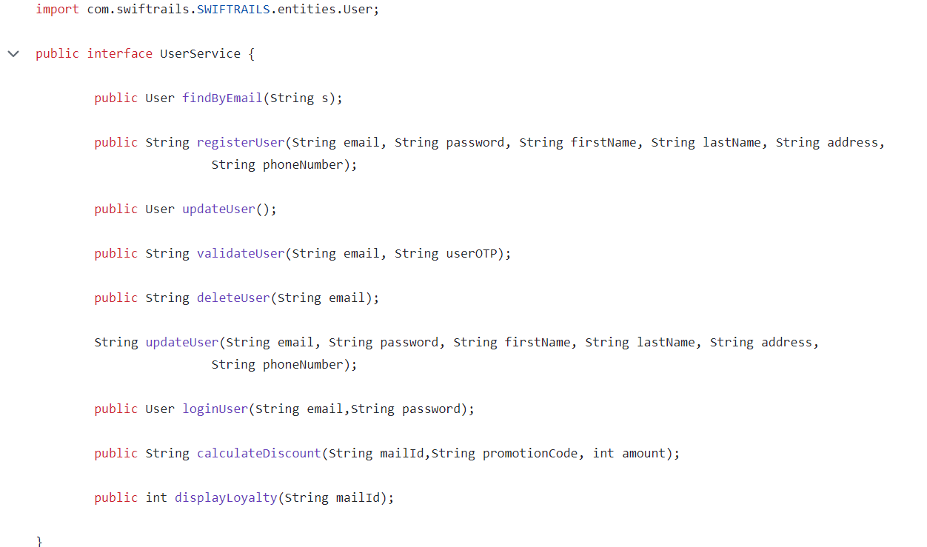
SERVICE

Slide 8
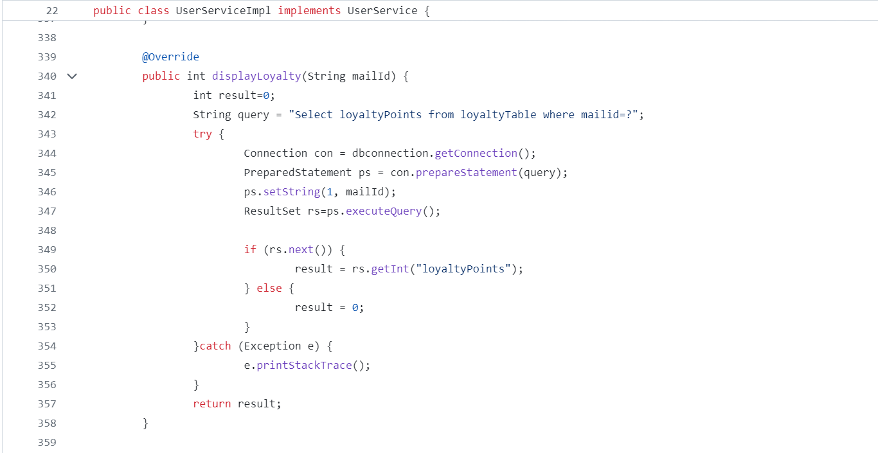
IMPLEMENTATION

